Slide 1

Introduction to Javascript
Rufo n. gabrillo jr.

Slide 2

Origins of HTML and Javascript
What is HTML?
HTML (HyperText Markup Language) is a markup language(code-based annotation system).
What is HTML5?
The 5th version of HTML, which was last updated in 1997. It is designed for all of our modern devices.

Slide 3
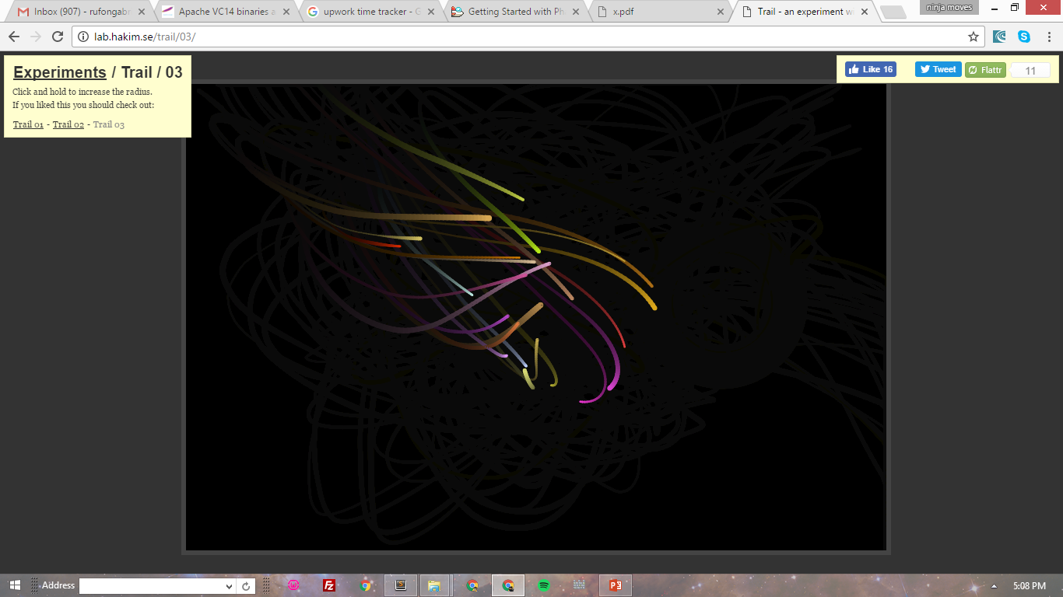
What is <canvas>?
An HTML5 tag that allows you to draw things in your browser using JavaScript.

Slide 4
What is Javascript
A 19-year-old programming language that is mainly used on the web. Allows dynamic interaction and effects to happen based on conditions and events.
<script type=‘text/javascript’>
alert(“hello world”);
</script>

